Slide 1
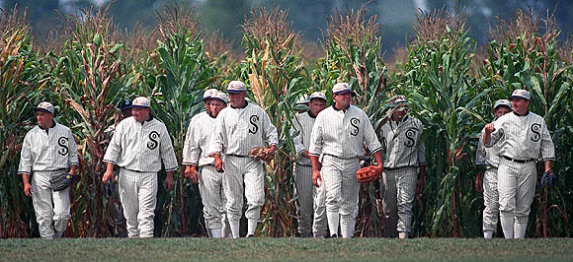
If You Build It…Will They Come?
Neil McNerney, M.Ed., LPC

Slide 6
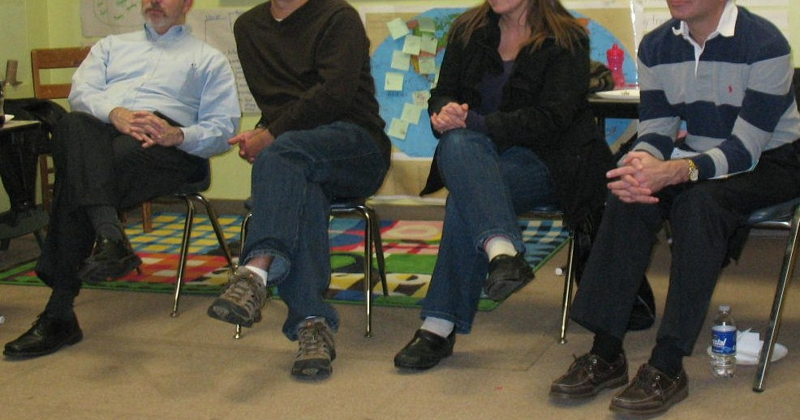
The Need

Slide 7
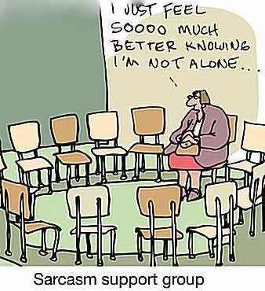
The Problem

Slide 8
Traditional Recruitment Techniques
Email
Email in all languages
Newsletters
Sign out front
Bulletin Board
Radio/TV
ONE WAY

Slide 9
Social Media
Facebook, Twitter, LinkedIn
ONE WAY

Slide 10
The Solution

Slide 11
Painting a Room

Slide 12
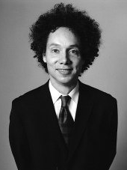
The Tipping Point
Malcolm Gladwell

Slide 13
The Three Crucial “Tippers”
Salespersons
Mavens
Connectors

Slide 14
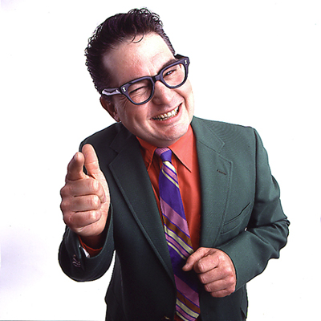
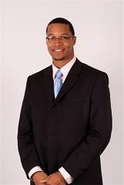
The Salesperson

Slide 15
The Maven

Slide 16
The Connector

Slide 17
Utilizing Connectors
Ask for specific help
Yes/No
“Can you do your best to get 6 neighbors to commit to coming?”
Check in weekly

Slide 18
Utilizing Mavens
Use their energy
Give specific ONE WAY tasks
Newspaper article
Newsletter

Slide 19
The Potomac Falls Experiment
Six Schools – Two Connectors Per School
At least one in target demographic

Slide 20
Results
Before – 5 signups
After - 148

Slide 21
Other Ideas That Worked
“I” messages about the program
Direct phone calls to those you want to attend
Two weeks before and then the day before
Child Care ALWAYS helps
Newspaper “Community Calendar” section
Facebook
Website – front splash page
Giveaways

Slide 22
Ideas That Don’t Work
Posters
“You really need this program…”
Road Signs
Worrying that program might get too big

Slide 23
Community Leaders
Who are your influential Parenting Partners?
Pastors, Family Ministers, etc.
Social Service Agencies
Child Care Centers
Martial Arts Schools
“Mandated” Professionals
Barbers, Hairdressers
Medical Offices

Slide 24
Community Leaders
Ask them for specific help:
“Can you use your church van to pick up a group of people that can’t make it otherwise?”
Can you attend?
Can you announce it at your services?
Can you invite 4 or 5 parents who would be interested?

Slide 25
Ineffective Asking
“Well, I sent out an email and asked for people to help. I even asked them to invite 2 or 3 other people to come, but it didn’t work.”

Slide 26
Effective Asking
“Hi, I’m planning an event and as I was planning it, I thought of you and wondered if you would be willing to help me. Can you call me back so we can talk about it? I think you’ll really like this program.”

Slide 27
Your Program
What hasn’t worked?
Identify Your Connectors and Mavens
Why did you pick them?
Create an ask for connectors and mavens
Brainstorm non-traditional tipping point people.

